Slide 1


Week 4 Lecture + Lab
Exploratory Data Analysis Continued
In-depth look into: Data encoding, Data Visualizations, Outliers

Slide 2

Data Encoding
Encoding Categorical Variables as Numeric

Slide 3
How to encode?
01 “FIND AND REPLACE”
02 LABEL ENCODING
03 ONE HOT ENCODING
04 CUSTOM BINARY ENCODING
05 ENCODING USING SCIKIT-LEARN

Slide 4
Data Visualization
More visuals to understand distribution of data

Slide 5
What visuals to use and when
Data distribution
Histogram
Density curve
Box plot
Compare values between groups
Bar chart
Dot plot
Change over time
Bar chart
Line chart
Observing relationships
Scatter plot
Bubble chart
Dual-axis plot
Heatmap
Part-to-whole
Treemap
Stacked area chart

Slide 6
Handling outliers
Identify the IQR (interquartile range)
IQR = Q3 – Q1
Identify upper and lower outliers
Upper = Q3 + (1.5 * IQR)
Lower = Q1 – (1.5 * IQR)
Subset data using upper and lower bounds to identify outliers within dataset
*Use Q3 and Q1 as thresholds

Slide 7
Questions to ask about outliers once found
Why do the outliers exist?
Even though they are outliers, could it be possible that the data makes sense with them?.
i.e. Salary data across the world which includes job position. Higher paying positions would indicate a higher salary, so outliers could stay in this instance as they could just be a representation of a subset of the data.
Are the values accurate?
Could there have been an error during data collection? if so, the outliers can be removed.

Slide 8
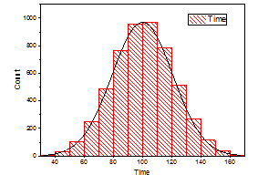
After removal of outliers
View distribution of data again
Once outliers are removed the data, use a histogram (with density curve) to view how it changed. Check to see if distribution of data is more/less skewed
Compare distributions pre outlier removal and post outlier removal to observe differences

Slide 9
To do for the week
Complete lab assignment –
Due on September 24th
Complete project checkup questions – Due September 24th
Create a new GitHub repository for both

